Slide 1
Beyond the Myths of Grief: Wisdom for Spiritual Accompaniment
Melissa M. Kelley, Ph.D.
April 21, 2018

Slide 2
Outline
Part 1: Myths of Grief and Beyond
varied and less recognized forms in which loss may occur
ambiguous loss
disenfranchised grief
narrative/meaning perspective
Part 2: Faith, Resilience, and Spiritual Accompaniment
The place of faith, resilience, and spiritual accompaniment as we
grieve and accompany others in their grief
Photo: https://hakuyako.deviantart.com/art/Tree-Branch-Silhouette-186582739

Slide 3
Proposed Definitions
What is bereavement?
"literally means the state of being deprived of someone by death" (Kaplan, Sadock, and Grebb, 1994, p. 80)
What is grief?
Distress in response to an important loss (adapted from Weiss, 2001, p. 47)
What is mourning?
Synonymous with grieving; cultural/social practices associated with bereavement

Slide 4
Part I
Myths of Grief and Beyond

Slide 5
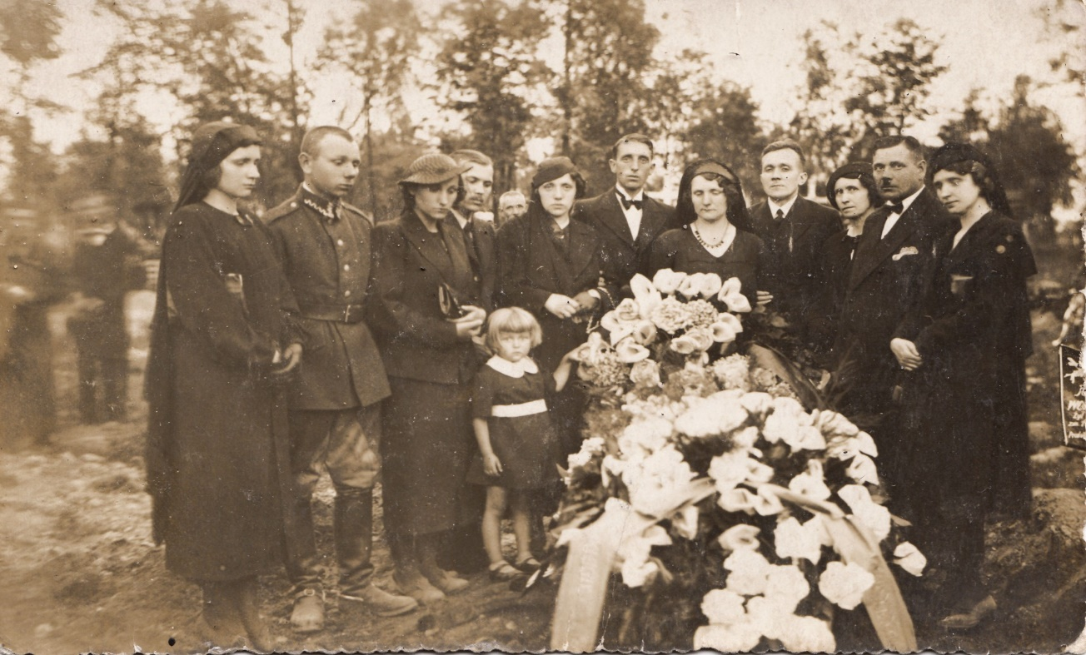
A Myth of Grief
Death is the experience that will typically prompt grief.
https://publicdomainpictures.net/en/view-image.php?image=40990&picture=my-grandfather-funeral&large=1

Slide 6
Beyond the Myth
Types of Loss
Material Loss
Relationship Loss
Role Loss
Functional Loss
Systemic Loss
Intrapsychic Loss
K. Mitchell and H. Anderson, All Our Losses, All Our Griefs. Westminster. 1984.

Slide 7
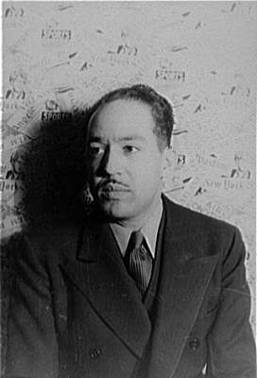
Intrapsychic Loss
What happens to a dream deferred?
Does it dry up
like a raisin in the sun?
Or fester like a sore—
And then run?
Does it stink like rotten meat?
Or crust and sugar over—
like a syrupy sweet?
Maybe it just sags
like a heavy load. Or does it explode?
Langston Hughes, “Harlem” from Collected Poems. Copyright © 1994 by The Estate of Langston Hughes
Image: Wikimedia Commons

Slide 8
Possible Faith/Spiritual Dimensions
Can we notice, name the varied losses we might be experiencing?
How have our many varied losses perhaps shaped our faith?
Can we trust that God sees every loss and cares deeply about our experience?
Photo: http://inspiringbetterlife.blogspot.com/2011/10/unrequited-nature-of-loss.html

Slide 9
A Myth of Grief
Standard Model (Hagman, 2001)
Grief is time-limited
Successful grieving brings closure, full resolution
[Photo: en.wikipedia.org]

Slide 10
Beyond the Myth
Ambiguous Loss – Pauline Boss (1999)
A loss that is “incomplete or uncertain” (1999, p. 3)
Example: someone may be physically present but psychologically absent
With ambiguous loss may come unresolved and/or ongoing grief

Slide 11
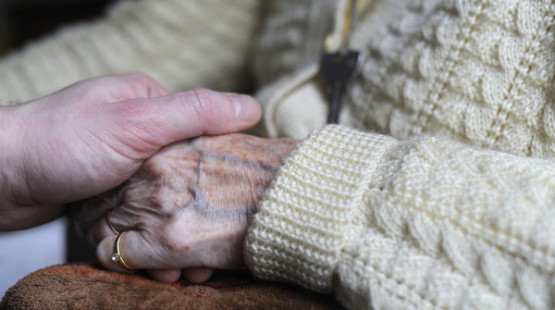
Possible Faith/Spiritual Dimensions
If we are grieving (unrecognized) ambiguous loss, do we worry that our faith is weak or inadequate?
Do we feel able to bring ambiguous loss and unresolved grief to our relationship with God?
Photo: https://www.wired.it/scienza/medicina/2014/05/15/antidepressivi-contro-alzheimer/

Slide 12
A Myth of Grief
Sometimes we may hold certain assumptions about grief care:
As spiritual caregivers, we will know when others are grieving
We will treat all experiences of grief as important and deserving of care
Photo: https://www.flickr.com/photos/tkksummers/4382779679

Slide 13
Beyond the Myth
Disenfranchised Grief: Kenneth Doka (1989, 2002, 2008)
Grief that is “not openly acknowledged, socially validated, or publicly observed” (2002, p. 5)
Example: losses related to pregnancy or childbirth are often disenfranchised
With disenfranchised grief, support is often lacking or withheld

Slide 14
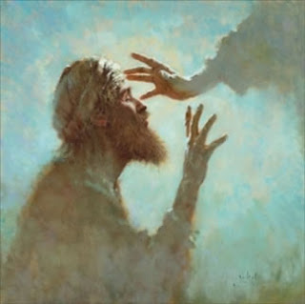
Possible Faith/Spiritual Dimensions
Can we trust that God sees all of our struggles and acknowledges our grief? Can we provide this acknowledgment and support for one another?
Matthew 5:4: Blessed are those who mourn, for they will be comforted.
As caregivers/directors, do we notice/privilege some griefs over others? Why might this be?
Photo:http://www.follow-the-light.org/2009/10/why-did-jesus-heal.html

Slide 15
A Myth of Grief
Standard Model (Hagman, 2001)
Grief is a clear, predictable process of decathexis (withdrawal of energy)
This model is not concerned with the meaning of a loss
[Photo: en.wikipedia.org]

Slide 16
Beyond the Myth
Narrative Perspective (Robert Neimeyer, 2001)
We are people of stories
We think of our lives in terms of stories – received and created
Central elements:
Plot
Theme
Characters
Timing
Continuity
Sense/Coherence

Slide 17
Narrative Disruptions (Neimeyer, 2000)
The meanings of our lives are embedded in our stories
Loss can disrupt our life stories, and the embedded meanings
Example: An unexpected loss may make a hopeful future seem impossible

Slide 18
The Great Challenge of Loss
“Like a novel that loses a central character in the middle chapters, the life story disrupted by loss must be reorganized, rewritten, to find a new strand of continuity that bridges the past with the future in an intelligible fashion.”
- Robert Neimeyer
Neimeyer, R., 2001. “The Language of Loss: Grief Therapy as a Process of Meaning Reconstruction.” In R. Neimeyer, ed., Meaning Reconstruction and the Experience of Loss. Washington, D.C.: American Psychological Association, 261–92.
Notes:
18
18

Slide 19
Possible Faith/Spiritual Dimensions
Why is narrative disruption so painful?
Our life stories reflect the MEANING of our lives
Our life stories reflect our HOPE for the future
Narrative disruption may shake or challenge deep faith meanings and HOPE
Our FAITH may not adequately hold us through our grief
Photo: http://game-icons.net/lorc/originals/despair.html

Slide 20
Reflection
Has my understanding and/or experience of grief been shaped by any of the myths considered?
What might the newer understandings of grief open up for me?
What questions or concerns of faith or the spiritual life are prompted for me?

Slide 21
Part II
Faith, Resilience, and
Spiritual Accompaniment

Slide 22
Resilience
When faced with loss, change and grief, we must respond in some way.
When loss and change are challenging, our coping skills are needed/tested.
Some attempts to cope may help us ‘survive’ but little more.
How might we cope in ways that may allow us
to THRIVE???

Slide 23
What Is Resilience?
“Resilience is essentially a set of skills – as opposed to a disposition or personality type – that make it possible for people not only to get through hard times but to thrive during and after them. Just as rubber rebounds after being squeezed or squished, so do resilient people.”
M. Oaklander, “Bounce Back,” p. 38
“We have many ways of overcoming adversity. Resilience is the capacity to adapt successfully in the face of threats or disaster. People can improve their capacity for resilience at any time of life.”
“This Emotional Life,” PBS online

Slide 24
Resilience and Self-Care
What is the relationship of resilience and self-care?
Self-care is a means of building or cultivating resilience – creating a mind and body and spirit that can respond effectively to and bounce back from adversity, challenge, etc.
“Taking care of yourself helps to keep your mind and body primed to deal with situations that require resilience.”
(“The Road to Resilience,” American Psychological Association)

Slide 25
Nurturing Resilience
Not ‘one size fits all’ in becoming more resilient. Many factors, skills seem to contribute, e.g.:
Strong spiritual life/relationship with God
Mindfulness VERY significant
Inner peace
Community/support/good friends
Belief that one can overcome adversity
Satisfaction in the job
Sources: See references
Good news! The brain can be trained to become more resilient:
“Forget the old adage that you won’t know what you’re made of until you’re tested; the latest science shows that if you train your brain, how you act under pressure can, in large part, be up to you.” (Oaklander, p. 38)

Slide 26
Ten Resilience-Builders (Source: Oaklander, p. 42)
“1. Develop a core set of beliefs that nothing can shake
2. Try to find meaning in whatever stressful or traumatic thing has happened
3. Try to maintain a positive outlook
4. Take cues from someone who is especially resilient
5. Don’t run from things that scare you: face them
6. Be quick to reach out for support when things go haywire
7. Learn new things as often as you can
8. Find an exercise regimen you’ll stick to
9. Don’t beat yourself up or dwell on the past
10. Recognize what makes you uniquely strong- and own it.”

Slide 27
Thinking Spiritually about Resilience
What gifts of our faith might help us to cultivate, draw on resilience in grief?
How might spiritual accompaniment help those who are grieving to cultivate, draw on resilience?

Slide 28
Thinking Spiritually about Resilience
Drawing on Oaklander, p. 42:
“1. Develop a core set of beliefs that nothing can shake”
God is love, and those who abide in love abide in God, and God abides in them. (1 John 4:16)
Blessed are those who mourn, for they will be comforted. (Matthew 5:4)
http://www.treatmetoafeast.com/2012/07/permission-to-love.html

Slide 29
Thinking Spiritually about Resilience
Such core beliefs help us to trust
that God sees all of our losses
that our grief is not disenfranchised
that God’s love is ultimate meaning
Spiritual accompaniment can offer, pray with, and model such beliefs.
Photo: https://www.flickr.com/photos/scriptureasart_/15476752501

Slide 30
Thinking Spiritually about Resilience
Drawing on Oaklander, p. 42:
“5. Don’t run from things that scare you: face them”
Even though I walk through the darkest valley, I fear no evil; for you are with me; your rod and your staff – they comfort me. (Psalm 23:4)
Photo: https://www.flickr.com/photos/johnloo/18666108579

Slide 31
Thinking Spiritually about Resilience
With trust that God is with us always, comforting us, we may
Face the varied losses of our lives
Learn to walk with ambiguous loss
Spiritual accompaniment can help us to trust that we never walk alone.
Photo: https://commons.wikimedia.org/wiki/File:Nature_park_Planicky_hreben_in_2011_(3).JPG

Slide 32
Thinking Spiritually about Resilience
Drawing on Oaklander, p. 42:
“2. Try to find meaning in whatever stressful or traumatic thing has happened”
For now we see in a mirror, dimly, but then we will see face to face. Now I know only in part; then I will know fully, even as I have been fully known. (1 Cor. 13:12)

Slide 33
Thinking Spiritually about Resilience
We will never solve the mystery of suffering and loss. But that does not mean our suffering is meaningless.
There is meaning in mystery, grounded in God’s unfailing love and care.
Meanings are co-constructed (Neimeyer), and spiritual accompaniment can help to co-construct meanings following loss that issue from God’s love.
Julian of Norwich:
We are “endlessly loved with an endless love.”
Photo: https://commons.wikimedia.org/wiki/File:Julian_of_Norwich.jpg

Slide 34
Thinking Spiritually about Resilience
Drawing on Oaklander, p. 42:
“3. Try to maintain a positive outlook”
I came that they may have life, and have it abundantly. (John 10:10)
Photo: https://sunshineuponmygarden.wordpress.com/2015/03/07/abundance/

Slide 35
Thinking Spiritually about Resilience
We have never been promised a life without suffering.
An abundant life will include loss and grief.
Spiritual accompaniment can help us to notice where God is active in our lives, bringing wholeness out of brokenness, in love.
Photo: http://inspiringbetterlife.blogspot.com/2012/10/the-defining-beauty-in-brokenness.html

Slide 36
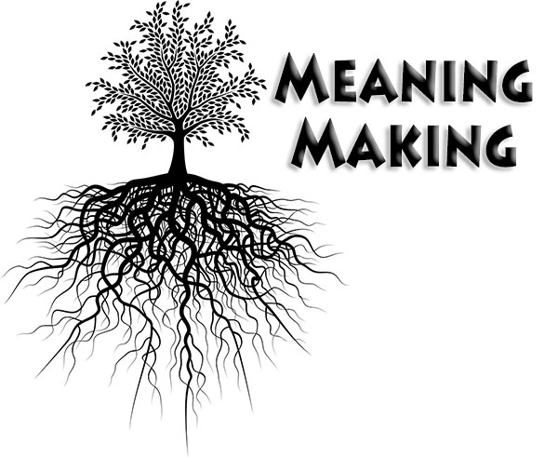
Thinking Spiritually about Resilience
Drawing on Oaklander, p. 42:
“6. Be quick to reach out for support when things go haywire”
Spiritual accompaniment may offer care and support that
notices and asks about the many losses another might face
Walks with another through ambiguous loss
Co-constructs meaning grounded in God’s constant love and care
Photo: http://www.the-vital-edge.com/knowledge-and-artificial-intelligence/

Slide 37
Thinking Spiritually about Resilience
Drawing on Oaklander, p. 42:
“9. Don’t beat yourself up or dwell on the past”
“in every end a new beginning lies hidden” (Jürgen Moltmann, 2004)
Photo: https://en.wikipedia.org/wiki/File:Garan_Sunrise.jpg

Slide 38
Thinking Spiritually about Resilience
Spiritual accompaniment may offer care and support that
notices and asks about the many losses of the past
Invites the other to notice God’s loving activity in the present
Supports the other in moving into the “open-ended future” with God (Lester)
Photo: https://www.flickr.com/photos/a_gods_child/4343286660

Slide 39
Reflection
How do we think about resilience in light of faith and the spiritual life?
Do we feel called to grow in deeper spiritual resilience?
How do we maintain our own resilience while supporting resilience in those whom we accompany?
At this moment, to what might God be inviting you?

