Slide 1
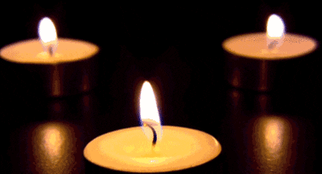
What is stirring in you as you reflect on these gifts and stories?
Which of these gifts do you feel moved to pray from/for?
Freedom
Reconciliation
Joy
Community and Family
Elders

