Slide 1
Insights on grief and loss
Nicholas Collura, MDiv.
nicholas.collura@gmail.com
www.nicholascollura.com

Slide 3
Henri Matisse, “The Dance”

Slide 4
GRIEF THEORY
(just a few basic thoughts!)

Slide 5
A Shift in Contemporary Grief Theory
from…
to…
Stage Theory
(Elisabeth Kübler-Ross and others)
Narrative Approaches
(Robert Neimeyer and others)

Slide 6
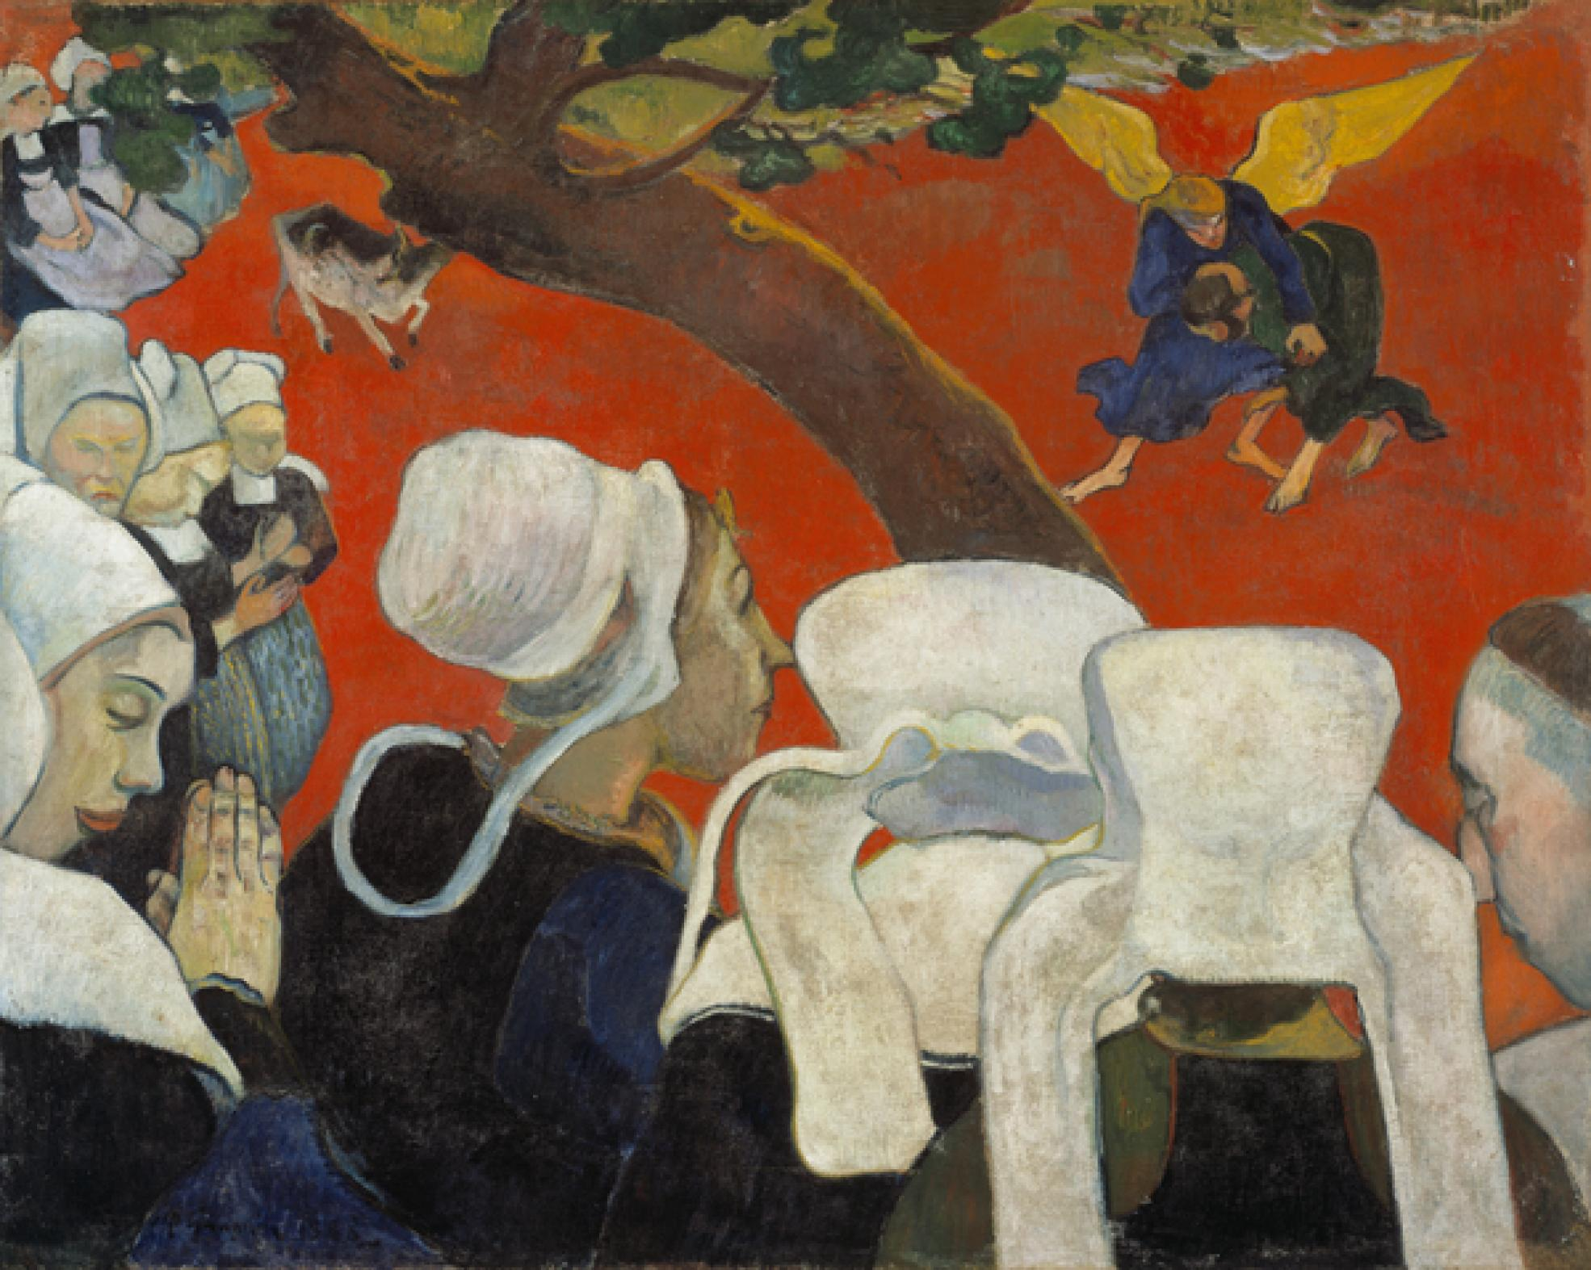
Paul Gauguin, “Vision After the Sermon”

Slide 7
A Grief Timeline:
Elisabeth Kübler-Ross (1926-2004)

Slide 8
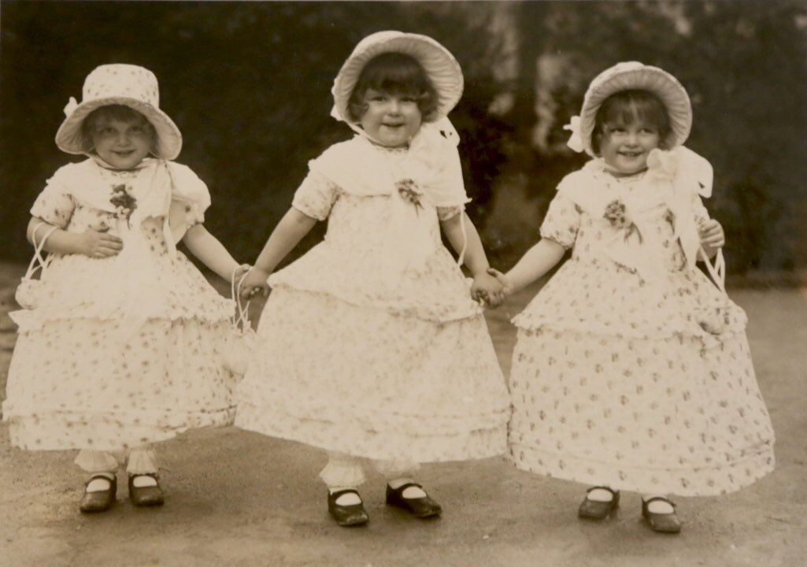
Elisabeth Kübler-Ross and her sisters

Slide 9
Maybe when something stops, something lost in us
can be heard…
Jack Gilbert,
from “A Ghost Sings, A Door Opens”

Slide 10
Past and Present Griefs that COVID May Trigger
Other times of loneliness
Other times when we felt out of control
Other times when we worried for our mental health
Other times when we felt our life was being wasted or was passing us by
Other times of personal or collective trauma
Other times when we felt despair for the earth / society / world
Other times when illness or tragedy kept us from participating in something meaningful

Slide 11
Pamela Hardesty, “Sacred Heart”

Slide 12
Three Important Reminders
All grief is personal, specific; these are not universal prescriptions, but invitations to our own individual reflection
It’s ok not to process grief before we are ready to do so; we can acknowledge grief but then put it into our “back pocket” until we are ready
Grief work is fundamentally an invitation to growth and healing. Grief is not the enemy; rather, it is our own spirit’s best attempt to respond to the antagonism of loss

Slide 13
Naming Loss

Slide 14
Naming Loss: Ambiguous Loss
Pauline Boss, PH.D.

Slide 15
Giorgio de Chirico, “Montparnasse
(The Melancholy of Departure)”

Slide 16
Ambiguous Loss
People killed in war: physically absent, psychologically present
Survivors of war, people with dementia: physically present, psychologically absent
Ambiguities of COVID Pandemic: interplay of absence and presence in virtual relationships, relationship to the world around us, even the invisible virus itself
Living with ambiguity, imperfection, the “in-between”

Slide 17
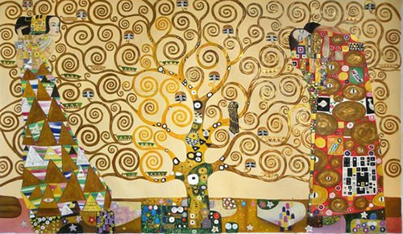
Gustav Klimt, “The Tree of Life”

Slide 18
Naming Loss: Anticipatory Grief
Future-oriented
May express itself as anxiety
Importance of mindfulness, rooting in the present moment
Importance of framing future-oriented thinking with hope

Slide 19
Naming Loss: “Civic Sadness”
Our investment in the life and well-being of the world / society / planet
This is a central element of our experience of this century (thinking of ecological disaster, visibility of extreme human rights abuses, etc.)
Grief may manifest itself as guilt over inaction or even over happiness
Importance of “trauma stewardship” (Laura van Dernoot Lipsky)

Slide 20
Naming Loss: Spiritual Loss
Randall Stoltzfus, “Thicket”

Slide 21
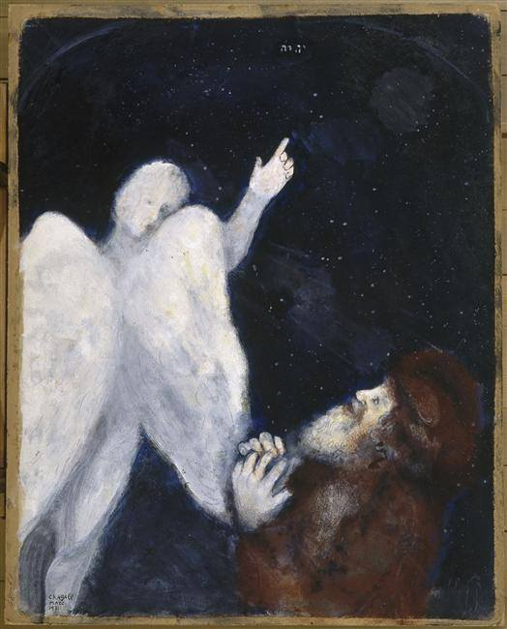
Marc Chagall,
“Noah Receives the Order to Build the Ark”

Slide 22
COPING
(in all things, balance)

Slide 23
Coping: Intuitive and Instrumental Grieving
Emotive Grieving
Cognitive Grieving
Active Grieving
Ritual Grieving

Slide 24
Coping: Moral Resilience
What to surrender?
What agency to accept?
Roshi Joan Halifax: “Consider what will serve”

Slide 25
Coping: Knowing Our Own Story
What have we lost and what must we grieve?
Who are we in our core, and what has remained?
What are we becoming or discovering in ourselves as resilient, expansive beings?

Slide 26
Coping: The Dual-Process Model of Grief
“Oscillation” between:
Processing Loss
and
Reinvesting in Life
(In our support networks, it’s good to have processors and distractors)

Slide 27
Coping: Self-Compassion
An exercise…

Slide 28
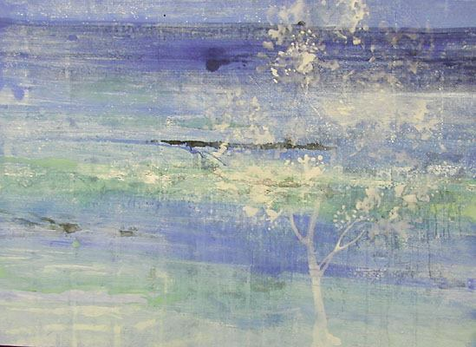
Makoto Fujimura,
“White Tree”

Slide 29
Thank you
(and be well!)

